Slide 1
Python for Physical Sciences Tutorial 4, Part One: Data Structures and Storage

Slide 2
Overview of data structures
We use data structures as a way of grouping multiple values under a single named variable/object.
You have likely already seen 2 data structures: lists and arrays.
We will take these concepts further and see how they are applied to analysis in astronomy.

Slide 3
What you know already
Both lists and arrays hold a sequence of elements.
We access elements using square brackets [] with an integer to specify location.
I.e. if we have -> my_list=[‘a’, ’b’, ’c’]…
-> my_list[1] -> ‘b’
There are multiple ways to alter the data stored in these.
i.e. We can use my_list.append(‘d’) to add an element to the end of a list.
Individual elements in lists can be any data type.
Elements in arrays must all be the same data type.
Mathematical operations can be applied to an entire array (if floats or integers):
I.e. -> np.array([1,2,3])*3 -> [3,6,9]

Slide 4
Dictionary data structures
Define with curly brackets {}, and assign each element a string designation as a key.
-> dictionary1 = {‘a’:1, ’b’:2, ’c’:3}
Access or modify elements using the key names rather than integers.
-> dictionary1[‘a’] -> 1
Add a new element with an unused key name:
-> dictionary1[‘d’]=4
-> dictionary1 -> {‘a’:1, ‘b’:2, ‘c’:3, ‘d’:4}

Slide 5
Nested Lists/Arrays
The elements in dictionaries can also be lists or arrays – we call these nested.
-> dictionary1 = {‘a’:[1,2,3], ‘b’:[4,5,6]}
-> dictionary1[‘a’] -> [1,2,3]
Access individual elements in nested lists or arrays with two square brackets.
-> dictionary1[‘a’][1] -> 1
Functions that modify lists/arrays also work on nested lists and arrays.
i.e. to append values to a nested list, we use -> dictionary1[‘a’].append()

Slide 6
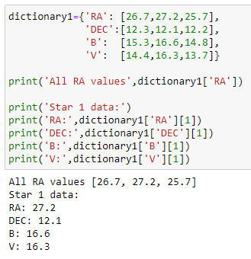
Real example – Photometry data
Having lists or arrays nested in dictionary data is useful for the physical sciences project work.
Example: information on stellar observations.
We may want to store several values, such as positions (right ascension and declination) and magnitudes in multiple wavelength bands (B and V).
These specific values will be our keys (i.e. ‘RA’, ‘DEC’, ‘B’, ‘V’).
Each element holds a list of values. A specific index in all these lists will correspond to data from a single star.
However, we can’t return all information on a single star simultaneously. There has to be a better way…

Slide 7
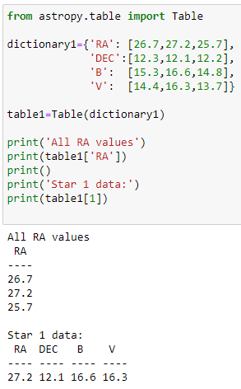
Tables
Tables are an alternate data structure to Dictionaries.
Several types exist in various packages – we will focus on Astropy.
-> from astropy.table import Table.
Easiest way of creating a table – use an existing dictionary structure.
-> table1=Table(dictionary1)
The keys we had become field/column headers. Access the data in a single column by entering its key as an index (i.e. -> table1[‘RA’]).
Returned columns operate and work as arrays.
Individual rows can be accessed with integers (i.e. -> table1[1]).

Slide 8
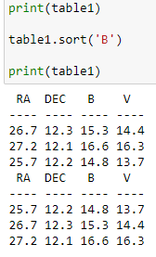

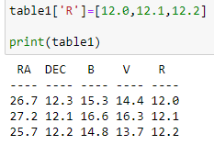
Things we can do with Tables
Sorting – using the .sort() function sorts all rows using the values in a single field.
See the current column names using .keys().
Add a new column by entering an unused column name with data:
-> table1[‘R’]=[12.0,12.1,12.2]
Can also set all elements in a new column to a single value, for example with -> table1[‘R’]=0.0
Most useful – makes it easy to save and open data.
First we need -> from astropy.io import ascii
Save a table to a file -> table1.write(‘my_table.csv’)
Open a saved table -> table1=ascii.read(‘my_table.csv’)

Slide 9
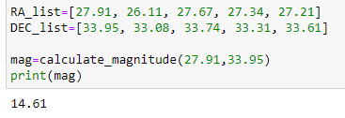
Task – Making a Table
Lets say we have we have a function that outputs a magnitude value when given a set of coordinates (i.e. a right ascension and declination).
i.e. -> mag=calculate_magnitude(RA,DEC)
Don’t worry about how this function works.
We also already have two lists containing coordinates (RA_list, DEC_list).
Our aim – make a table containing these coordinates and the associated magnitude values calculated for them.
How would you do this?

Slide 10
